Slide 1
Retinex Image Enhancement Techniques
--- Algorithm, Application and Advantages
Prepared by: Zhixi Bian and Yan Zhang

Slide 2
Introduction
Why called Retinex?
  An method bridging the gap between images and the human observation of scenes.
Origin of Retinex
  Proposed by Edwin Land¹ in 1986
  A model of lightness and color perception of human vision
No theoretical but experimentally proved Retinex
  An automatic imaging process
  Independent of variations in the scene

Slide 3
What could Retinex do?
Depending on the circumstances, Retinex could achieve
  Sharpening
    Compensation for the blurring introduced by image formation process
  Color constancy processing
    Improve consistency of output as illumination changes
  dynamic range compression

Slide 4
Development of Retinex techniques
Single Scale Retinex (SSR)
Multi-Scale Retinex (MSR)
Multi-Scale Retinex with Color Restoration (MSRCR)
Multi-Scale Retinex with canonical gain/offset

Slide 5
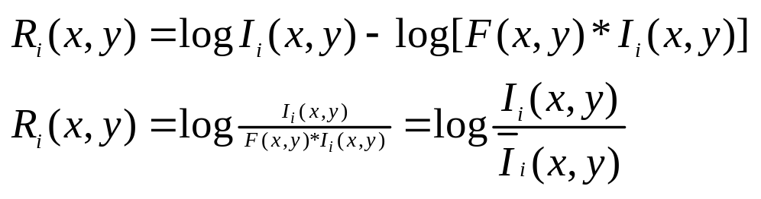
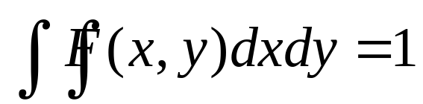
Single Scale Retinex (SSR)
Algorithm
  I_{i}(x,y): the image distribution in the i^{th} spectral band
  R_{i}(x,y): retinex output
  Gaussian function: F(x,y)=Ke^{-(x^2+y^2)/c^2}
    K determined by:
    C is the Gaussian surround space constant

Slide 6
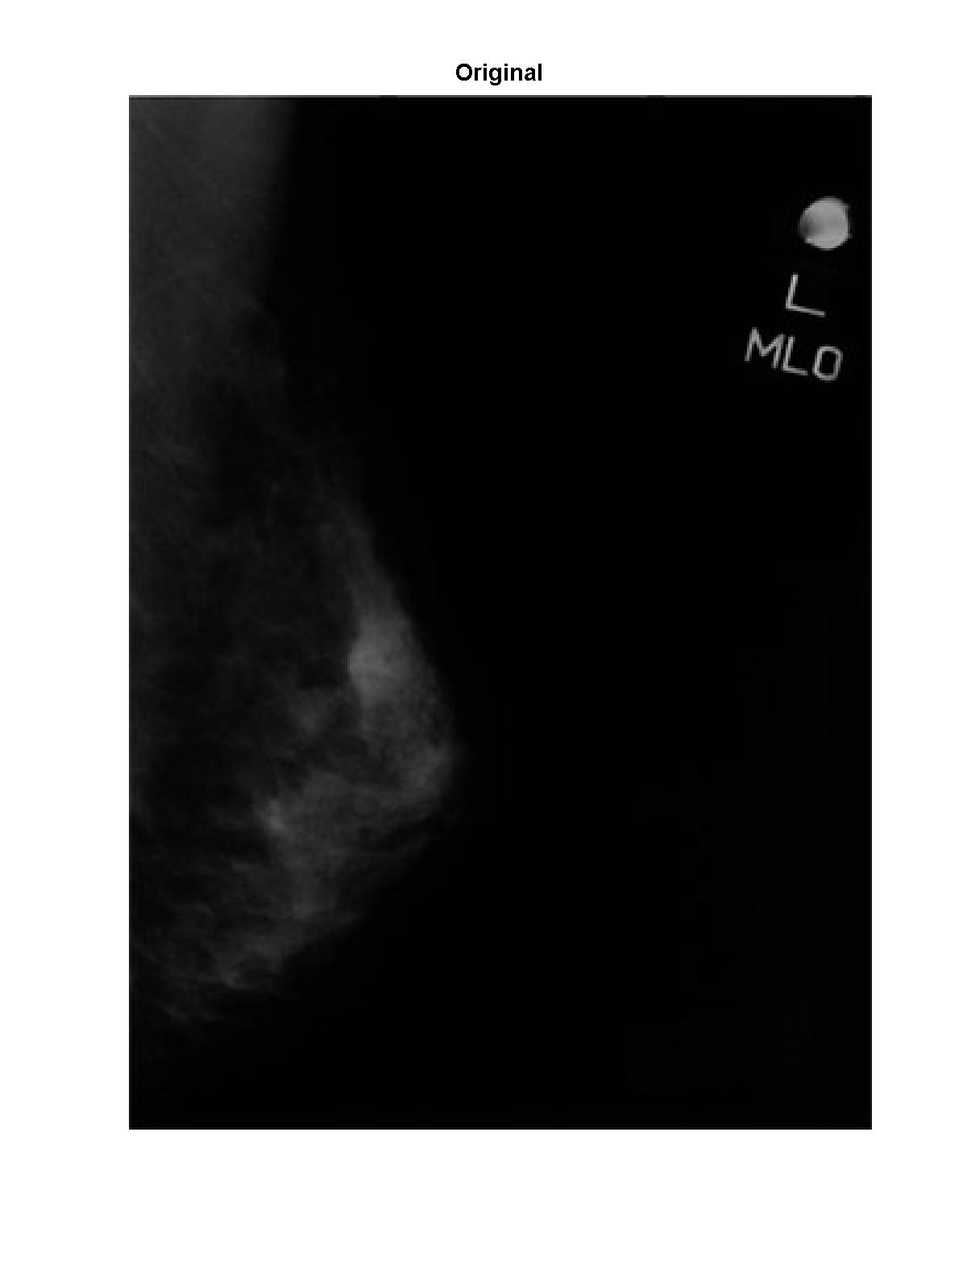
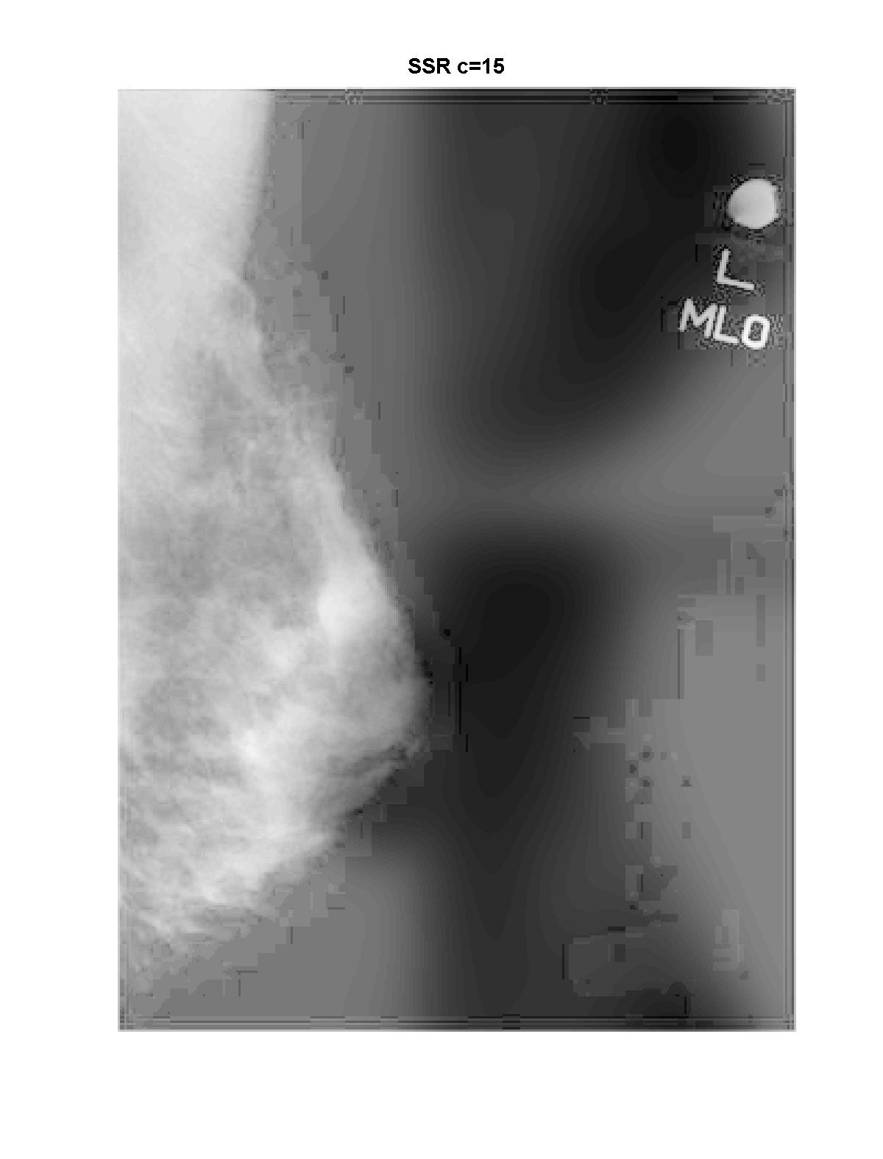
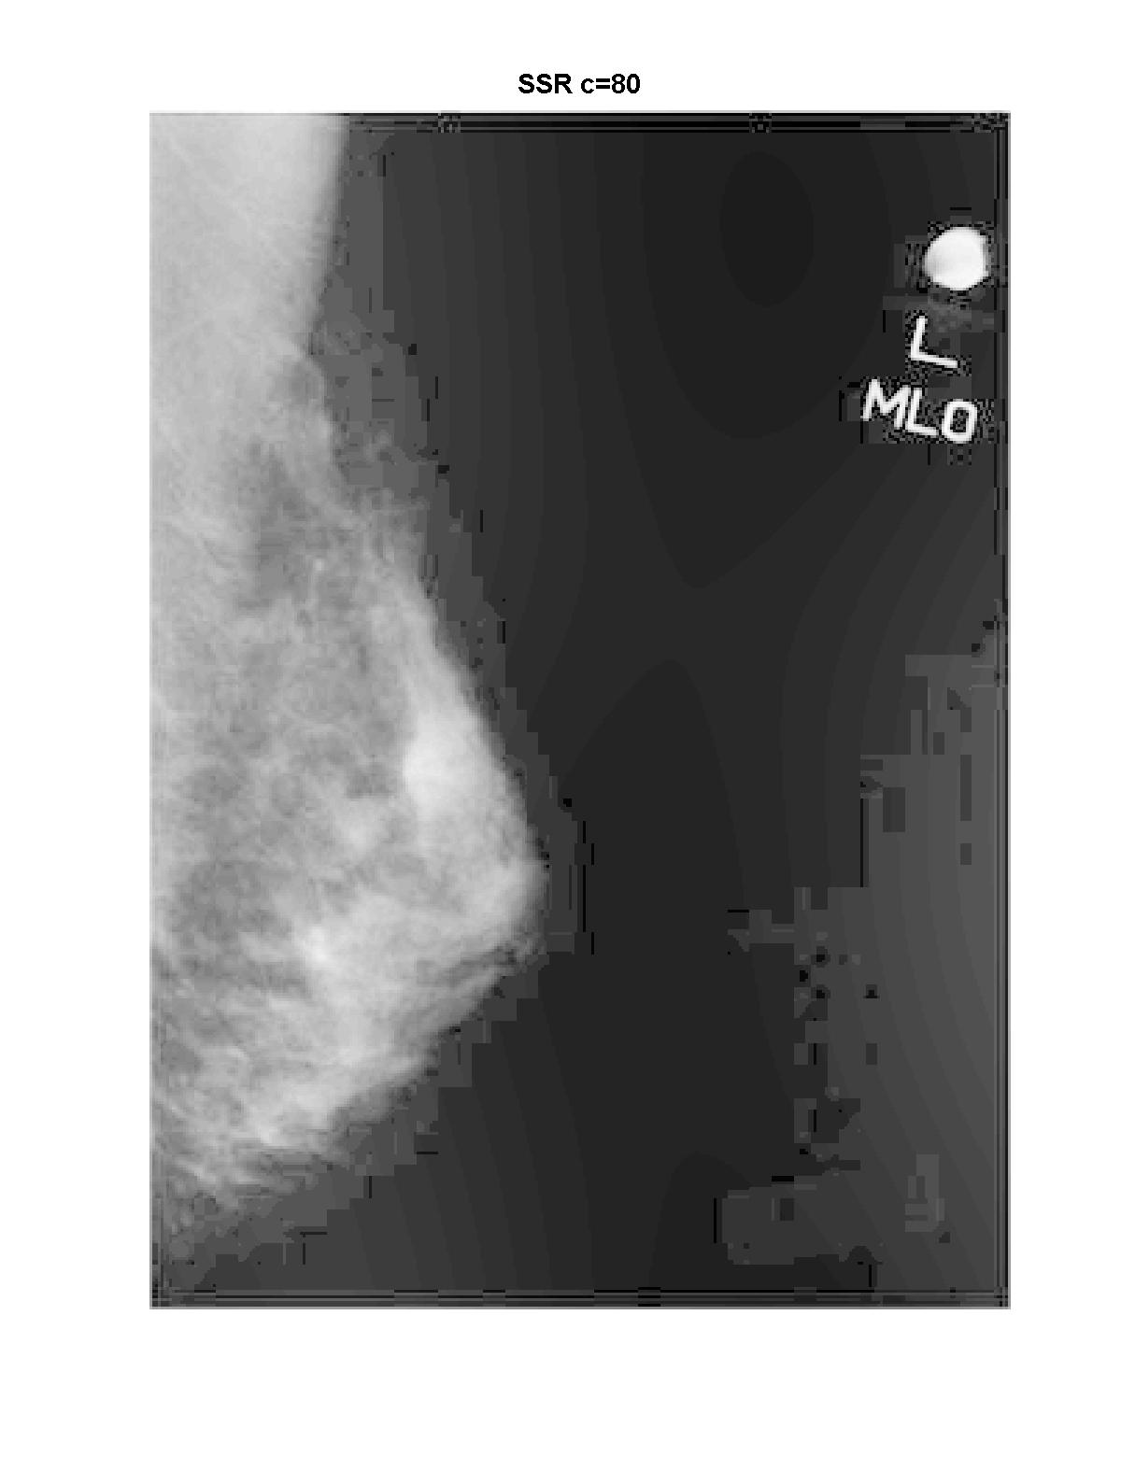
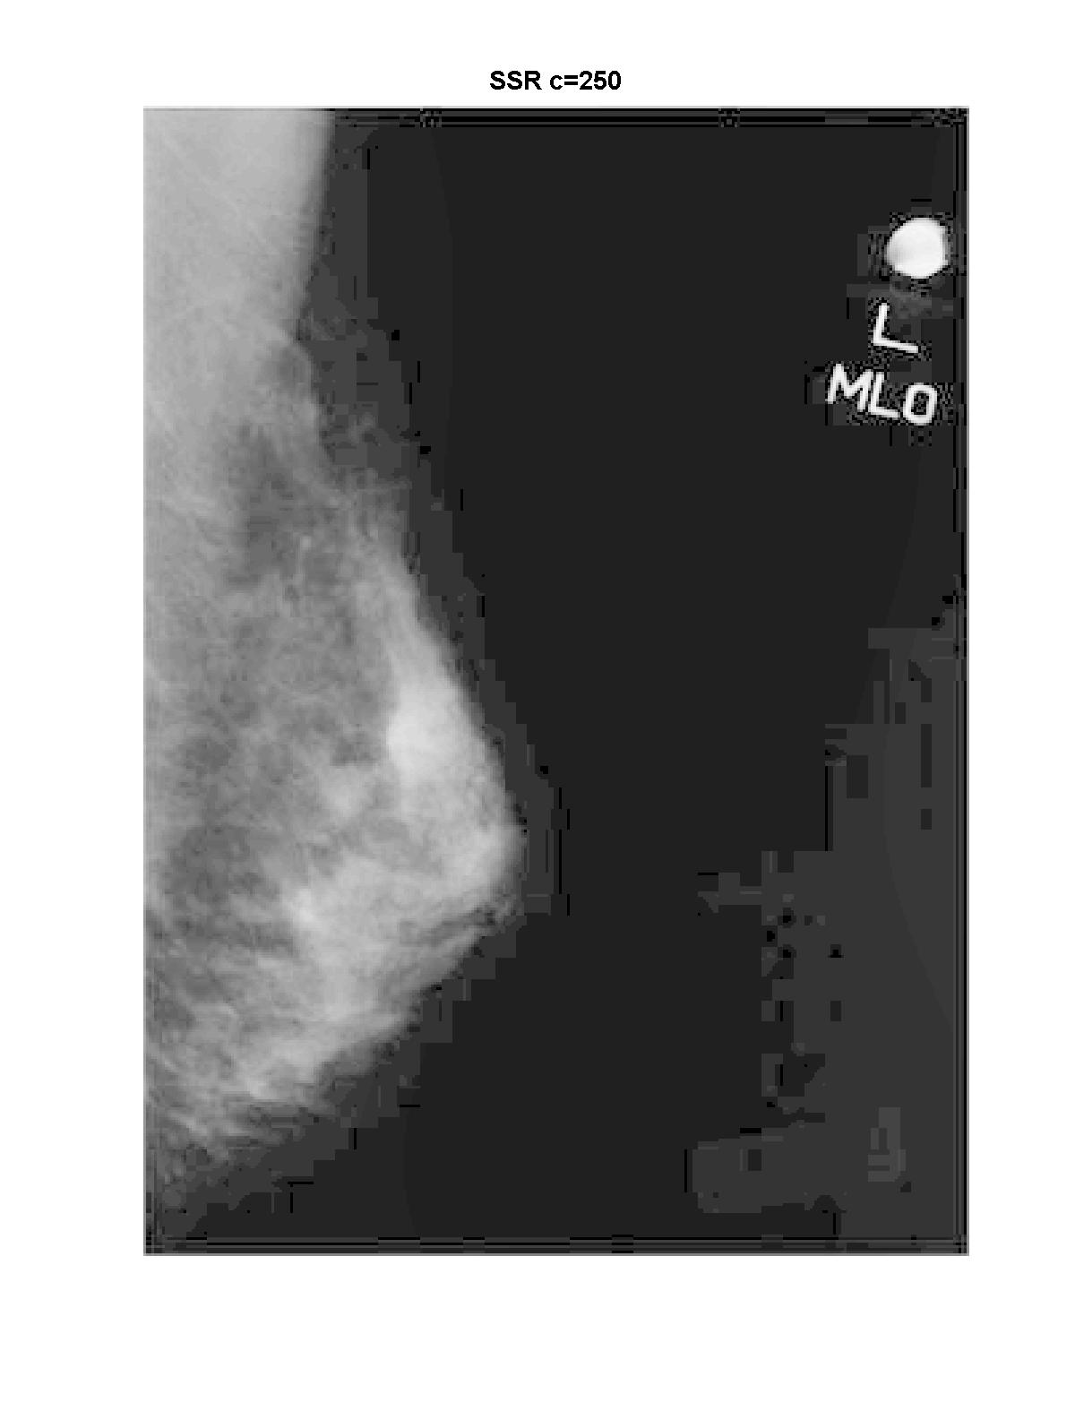
SSR result comparison with different gaussian constant I

Slide 8
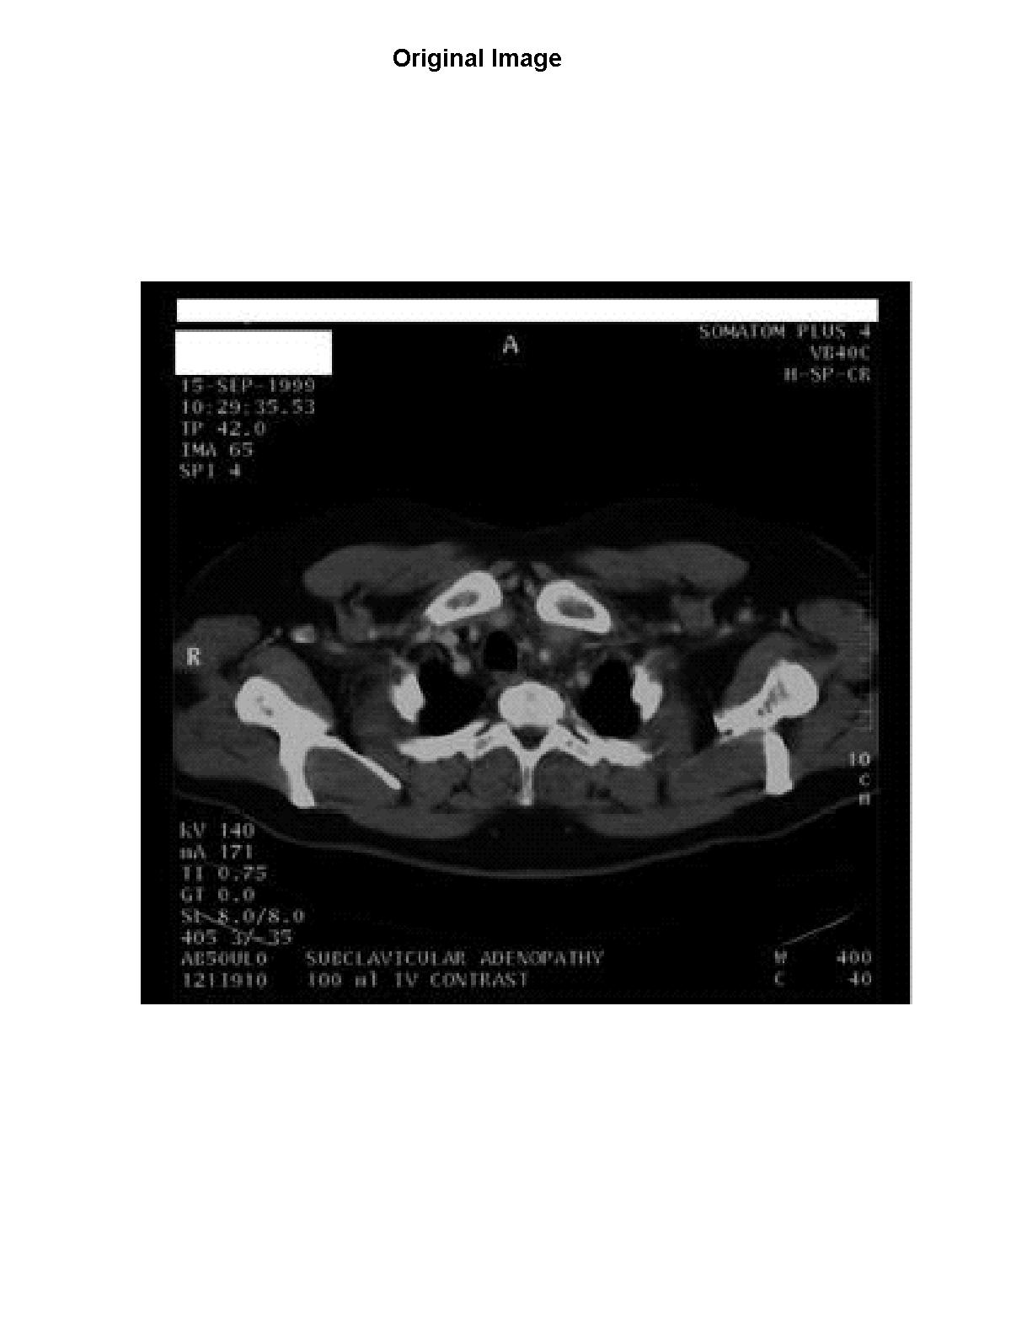
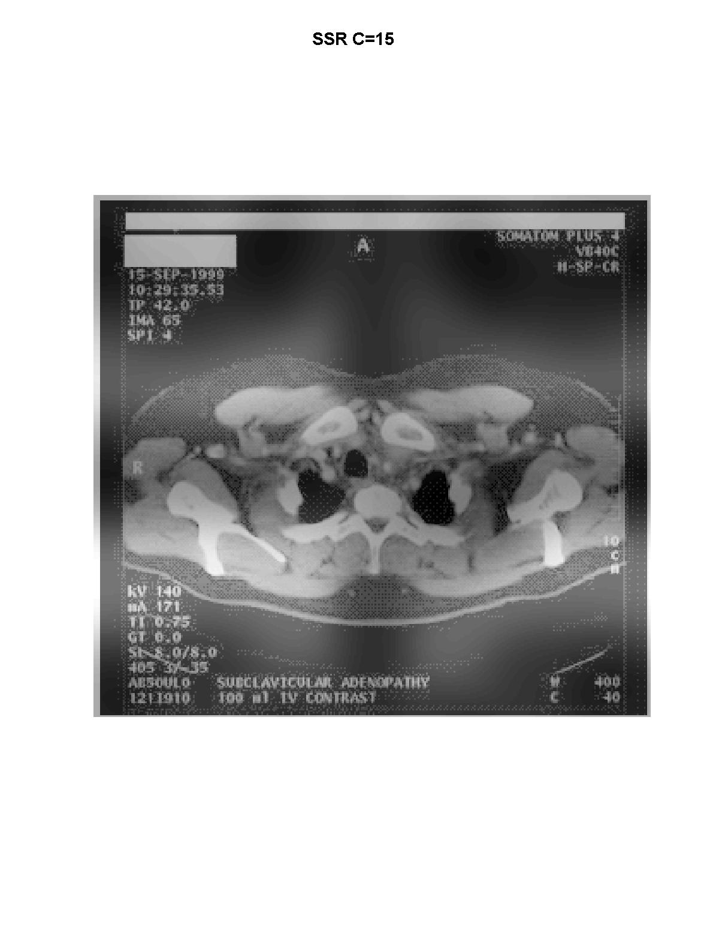
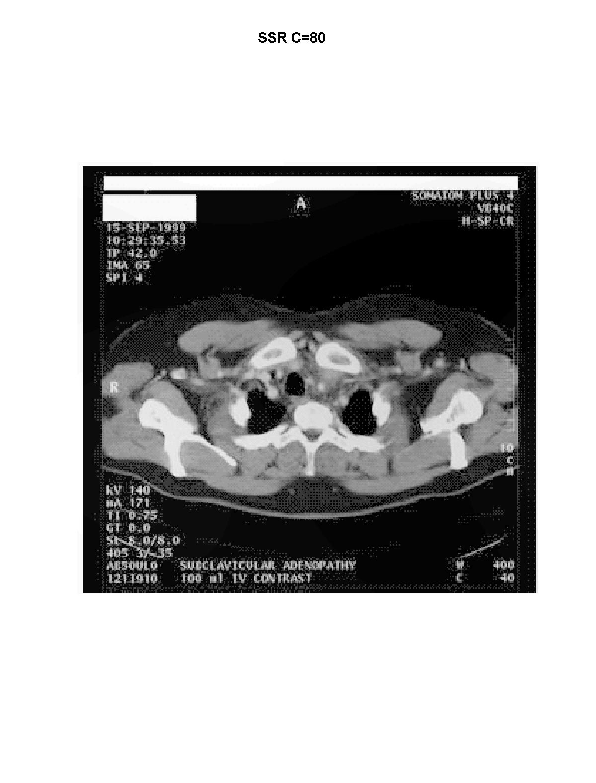

SSR result comparison with different gaussian constant II

Slide 10

Properties of Retinex
Trade-off btw compression and rendition
Small scale (small c)
Good dynamic
range compression
large scale (large c)
Good tonal rendition

Slide 11
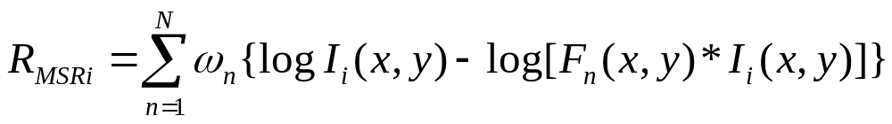
Multi-Scale Retinex (MSR)
SSR_{i}
Algorithm
  N: number of scales,
  ω_{n}: weight associated with the nth scale
  Empirical value:
    N=3, ω_{n}=1/3,
    C = 15, 80 and 250 correspondingly for each scale in F_{n}
Better than SSR in balance of dynamic compression and color rendition

Slide 12
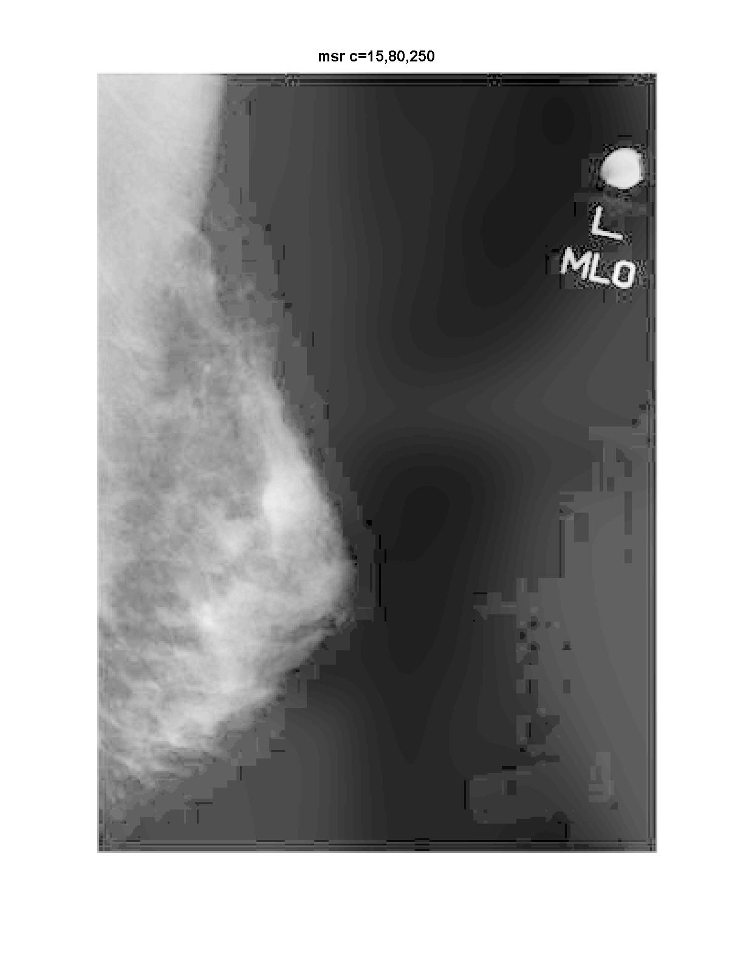
Comparison of SSR and MSR

Slide 13
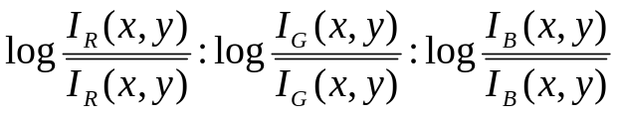
Improvements on MSR
-- Color Restoration
MSR is good enough for gray pictures
But not desirable for color pictures
  RGB proportion out of balance
    I_{R}(x,y):I_{G}(x,y):I_{B}(x,y) ==
Solutions
  Multi-Scale Retinex with Color Restoration (MSRCR)
?

Slide 14
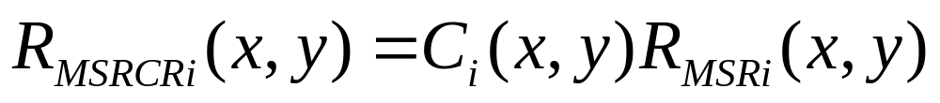

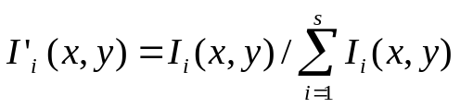
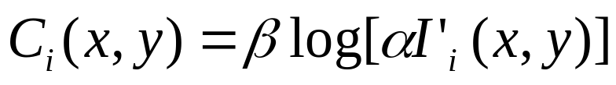
Multi-scale Retinex with color Restoration (MSRCR)
Algorithm
ith band color restoration function (CRF)
S is the number of spectral channels, general s=3
How to get the right C_{i}? ---- Mystery spot !!!
---- Value of the patent!!!

Slide 15
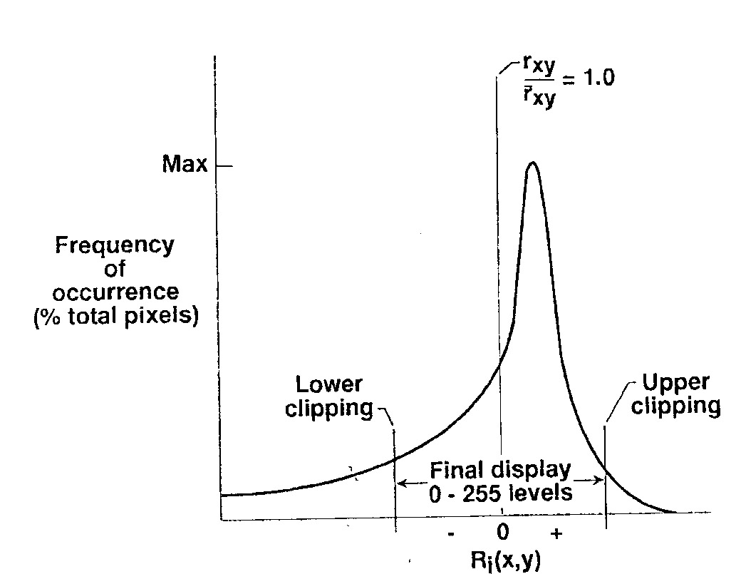
Further improvements on MSR
-- For better contrast
Characteristics of retinex pictures histogram
Solutions
  Canonical gain/offset
    Canonical: general constants independent of inputs and color bands
Where to clip off? ---- Mystery spot !!!
How much gain to add? ---- Value of the patent!!!

Slide 16
MSRCR with ‘canonical’gain/offset
Restored color and better contrast
Canonical gain/offset
  make a transition from the logarithmic domain to display domain
Algorithm
  The same G, b value in the paper couldn’t reproduce the better results
  Experimental values were achieved through several trials

Slide 17
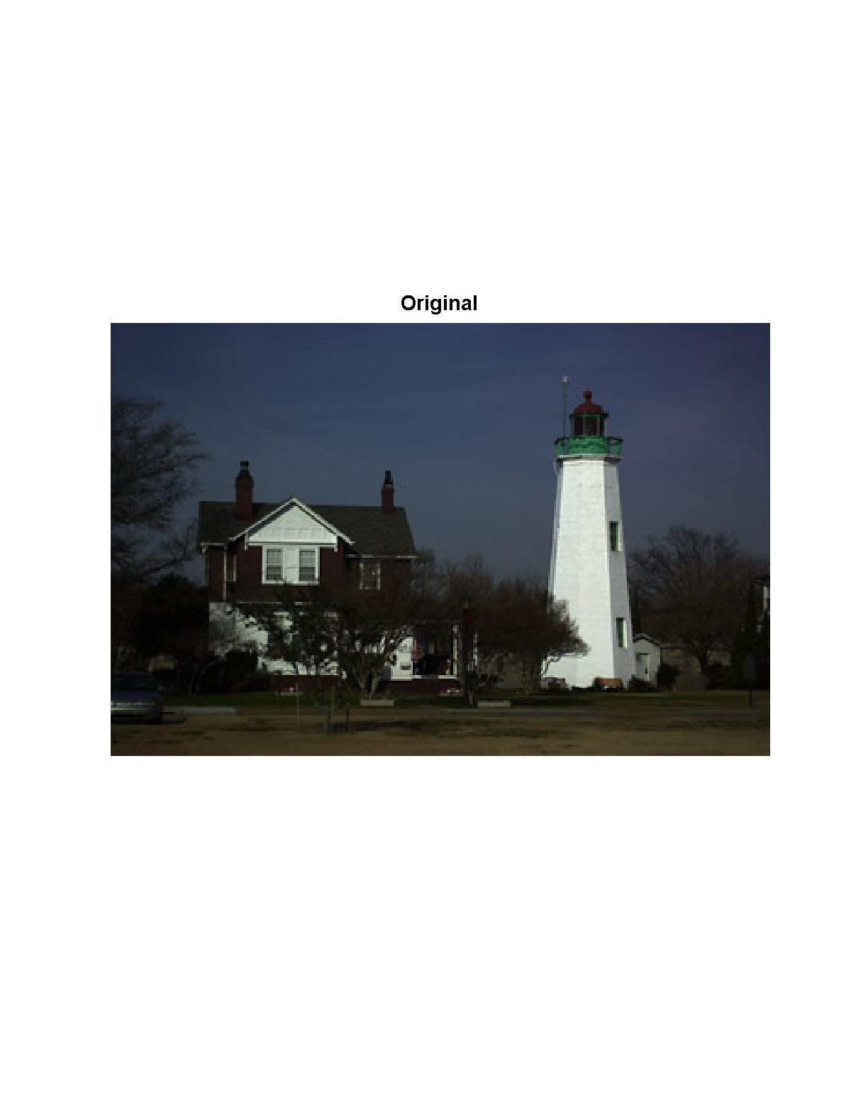
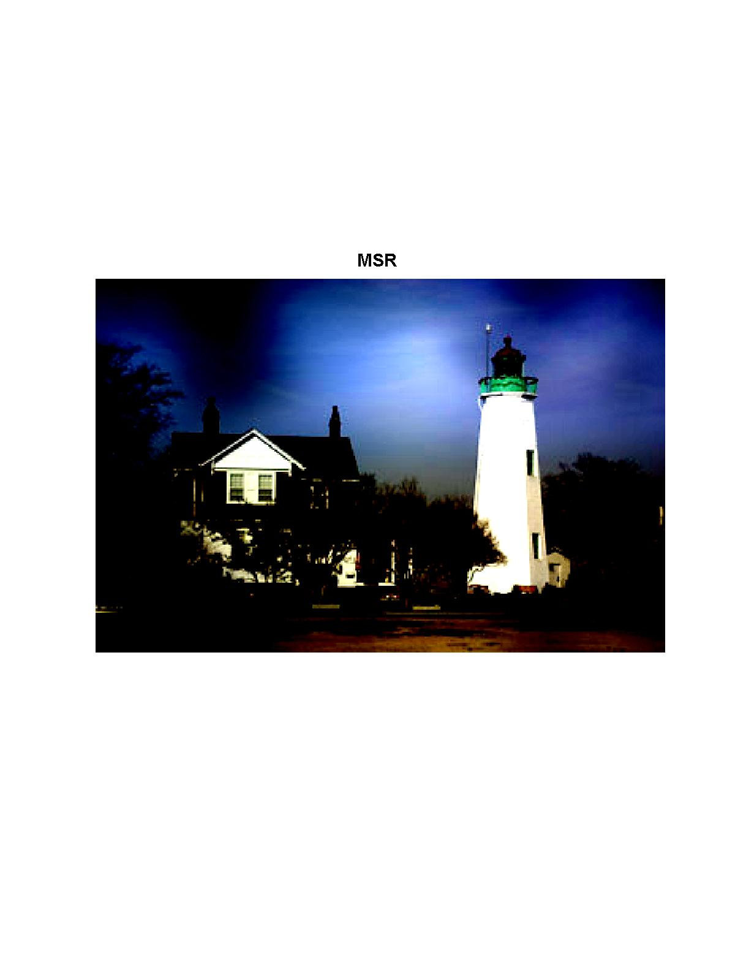
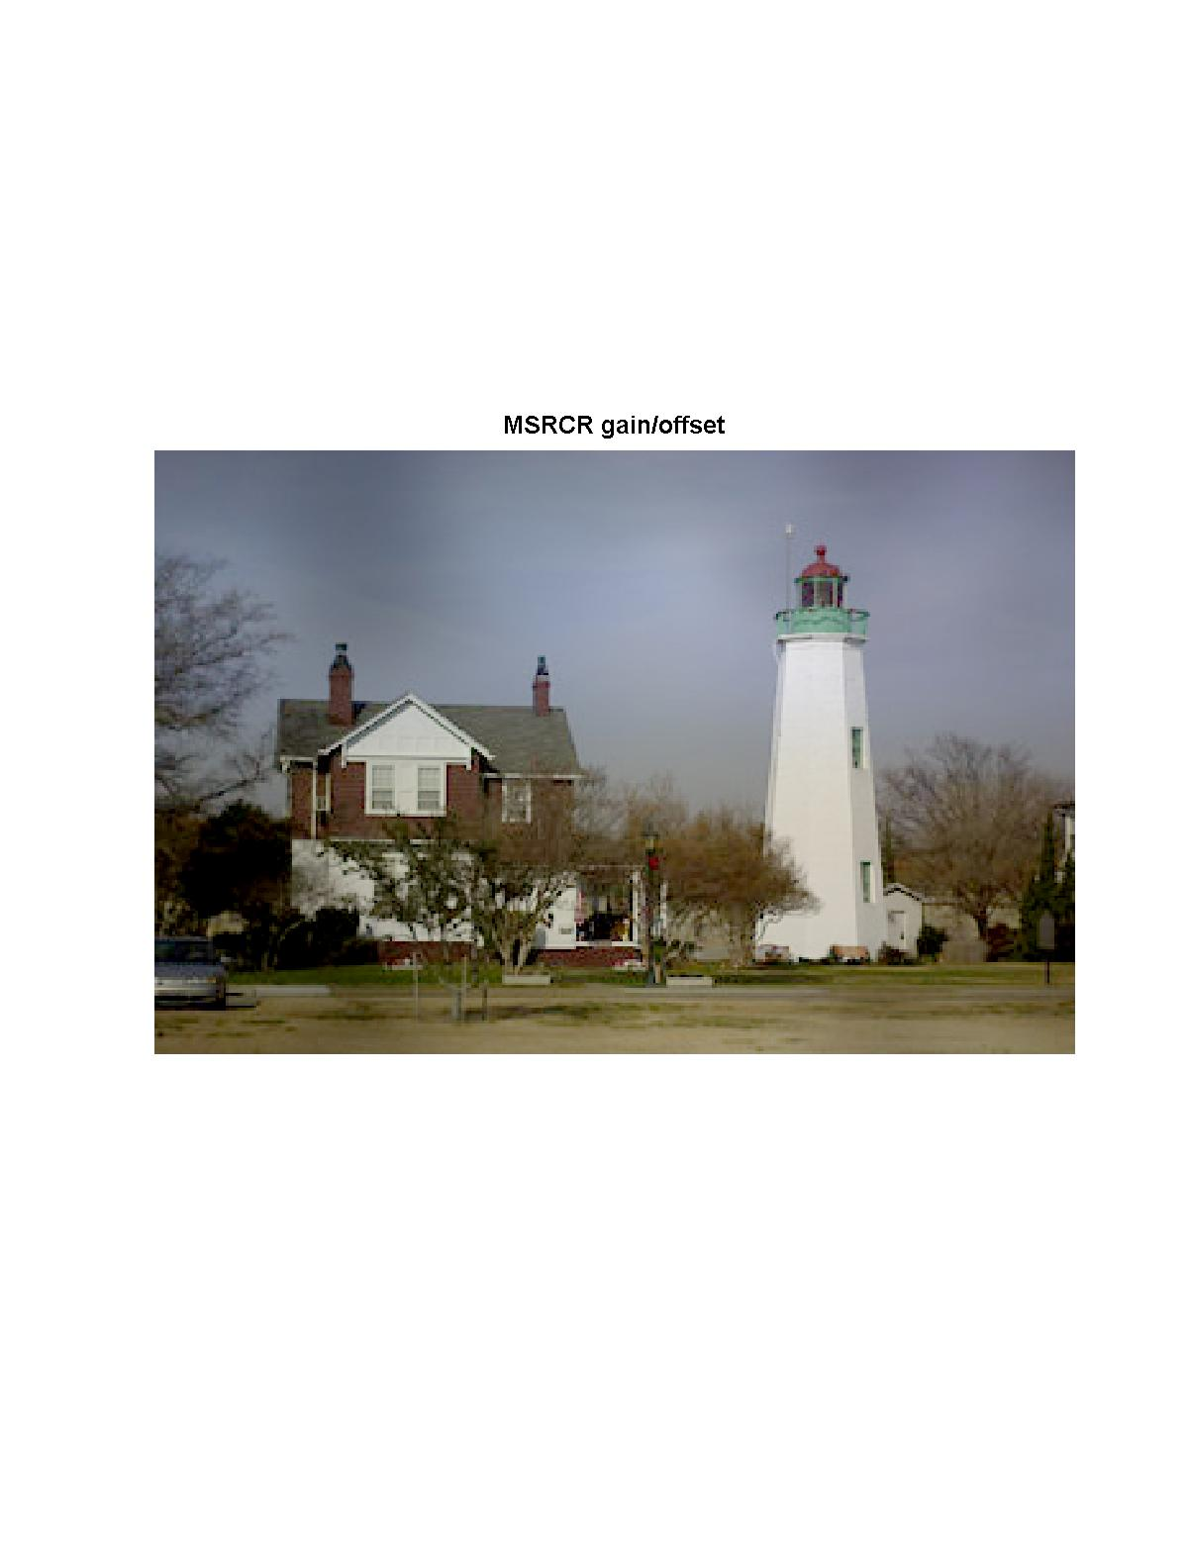
MSR compared with MSRCR gain/offset I

Slide 19
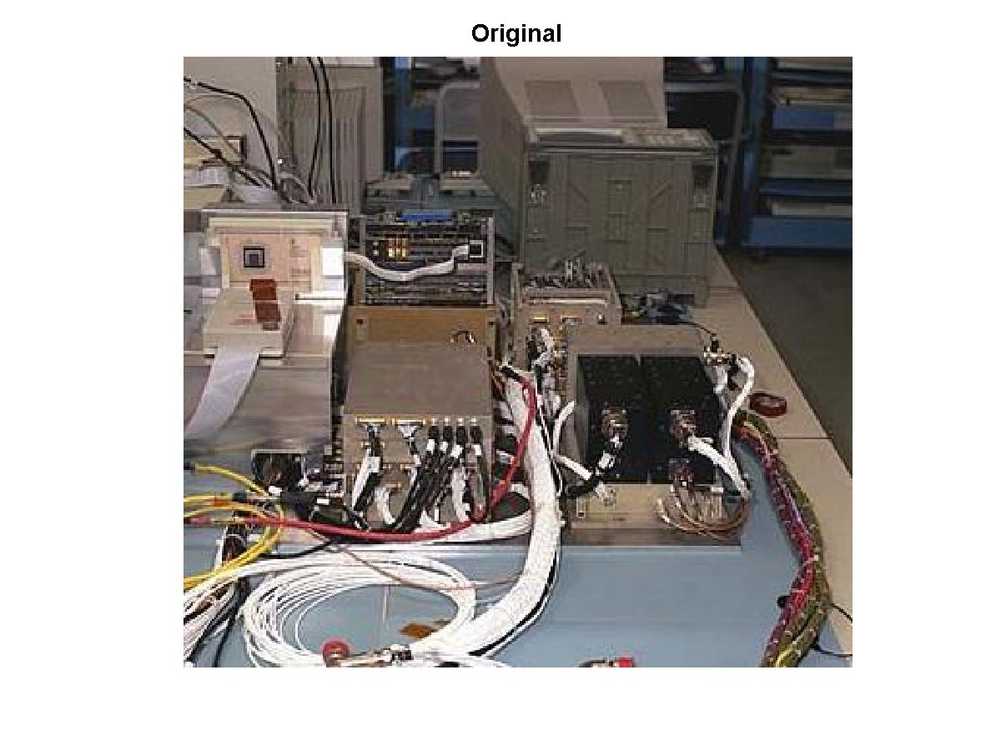
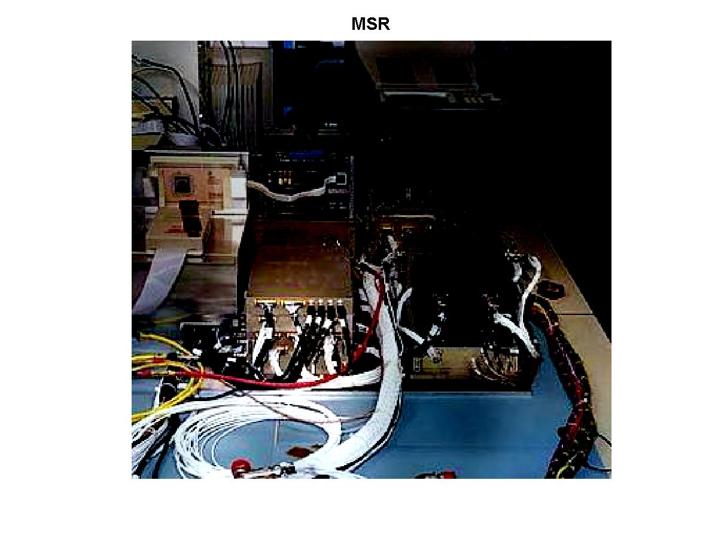
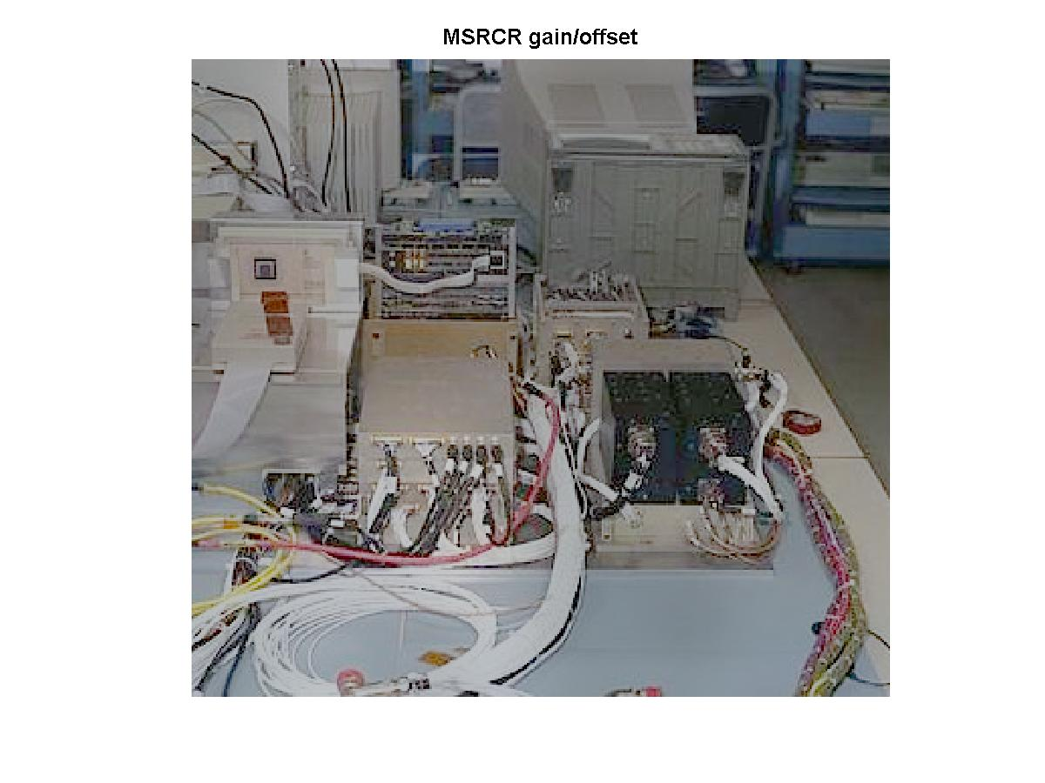
MSR compared with MSRCR gain/offset II

Slide 21
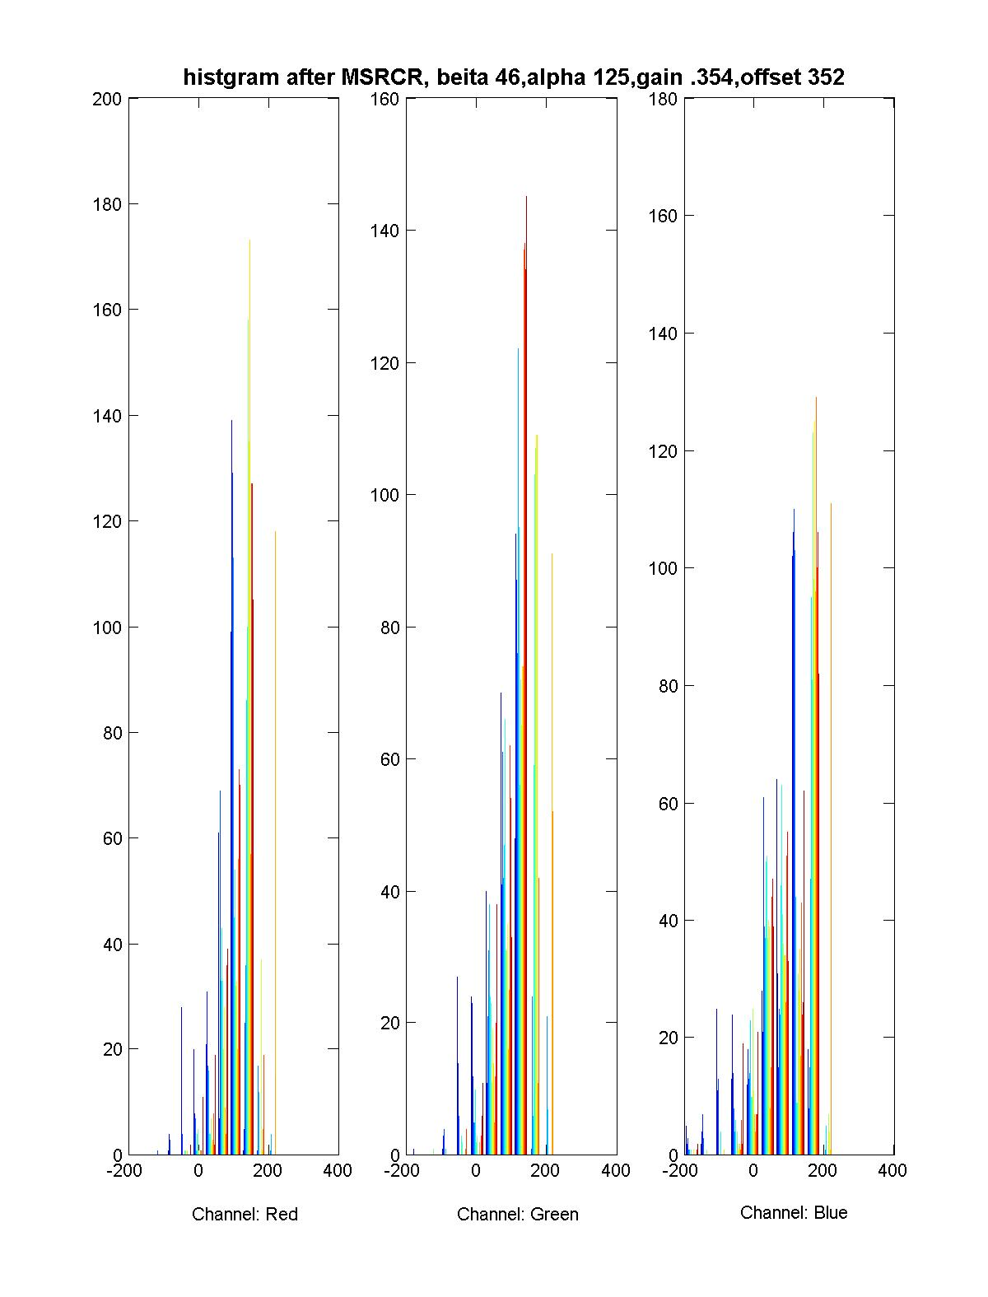
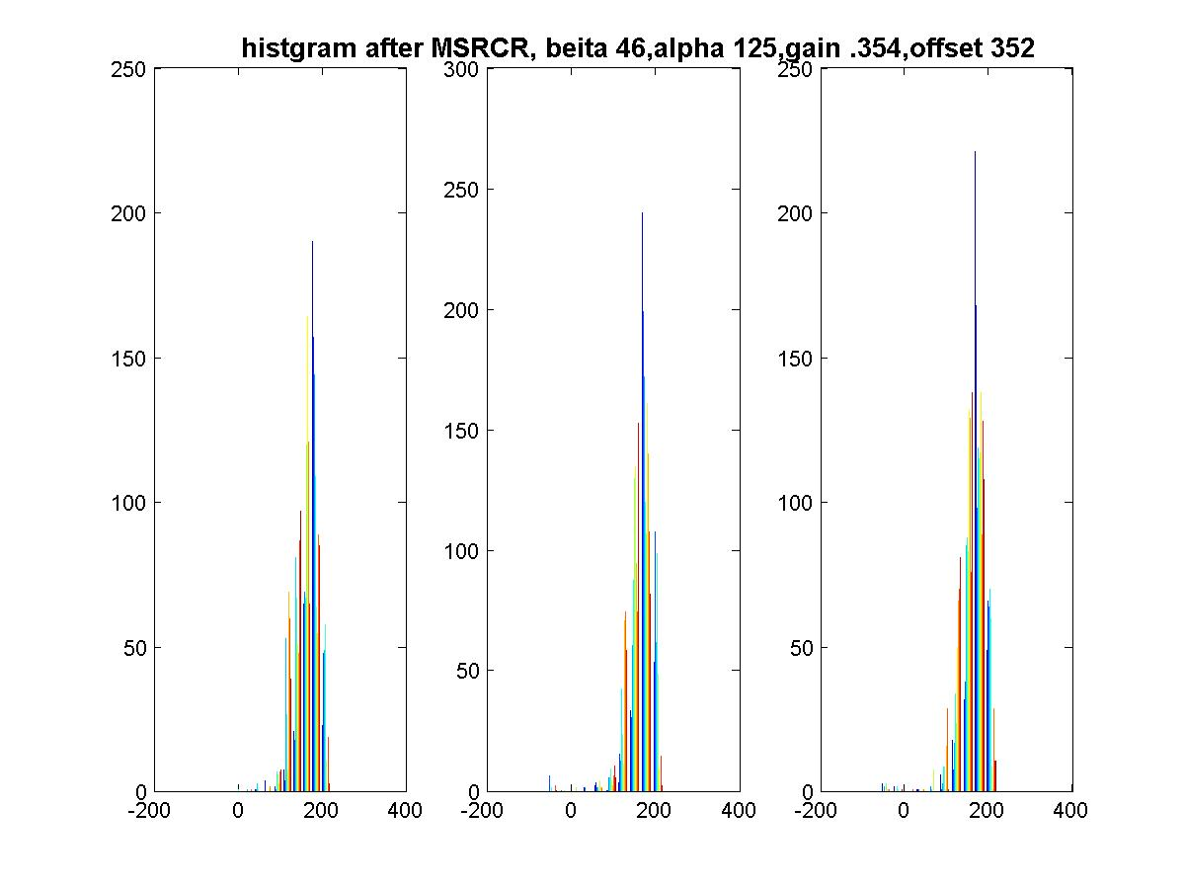
Histogram of MSRCR gain/offset
Characteristic gaussian distribution of RGB channels

Slide 22
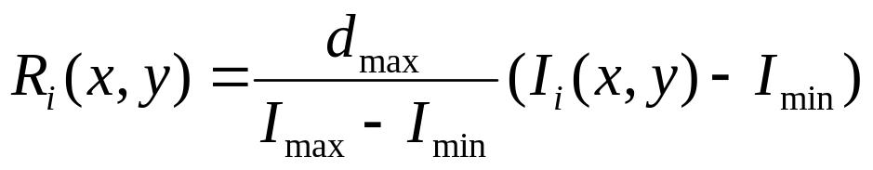
Other Image Enhancement Techniques-1
Gain/offset correction
  d_{max} dynamic range of display media, normally 255
  Pros
    Success on dynamic range compression
    Transfer the dynamic range to the display medium
  Cons
    Loss of details due to saturation and clipping

Slide 23
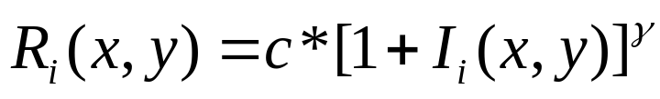
Other Image Enhancement Techniques-2
Gama Correction
  Pros
    Good for improving pictures too dark or too bright
  Cons
    Sacrifice the visibility in the ‘bright’
    Global function, no detail enhancement

Slide 24
Other Image Enhancement Techniques-3
Histogram Equalization
  Remapping the histogram of the scene to a uniform probability density function
  Pros
    Good for for scenes very dark or very bright
  Cons
    Bad for pictures with bi-modal histogram

Slide 25
Other Image Enhancement Techniques-4
Homomorphic filtering
Resemble to MSR
Difference: the last exponential part makes it go back to original domain
f(x,y)
ln
DFT
H(u,v)
(DFT)⁻¹
exp
g(x,y)
Gaussian high
pass filter

Slide 26
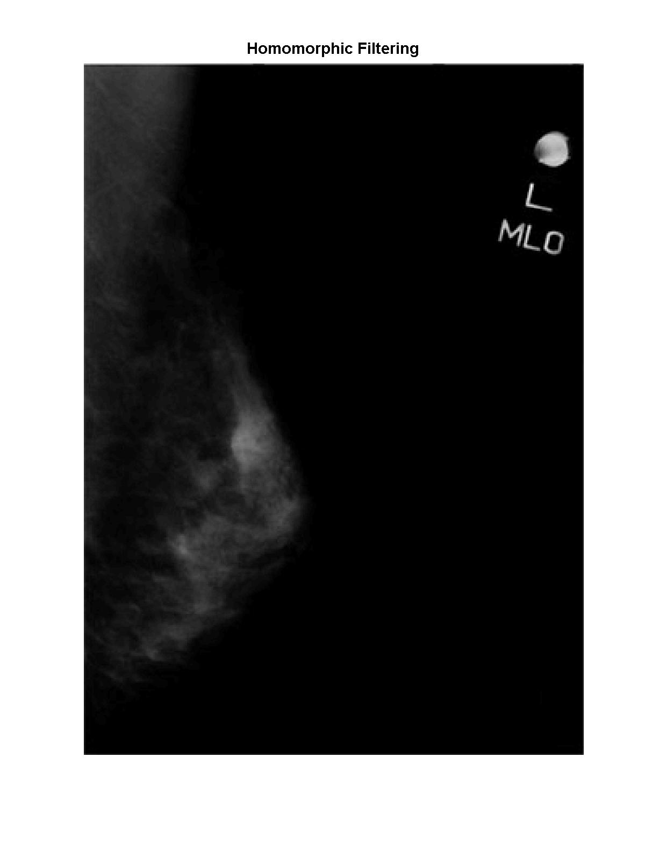
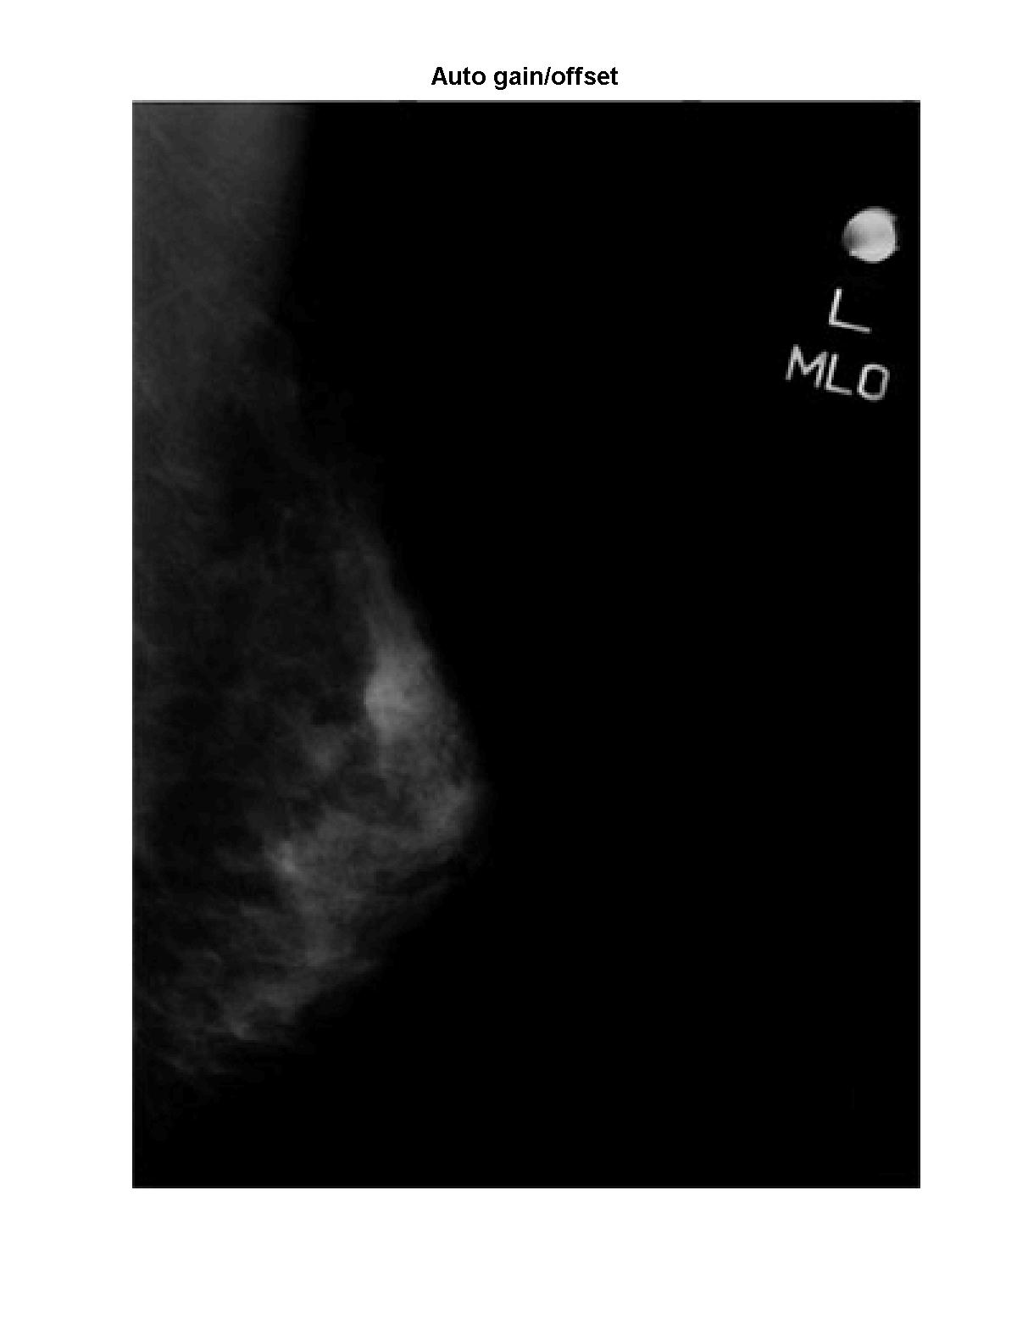

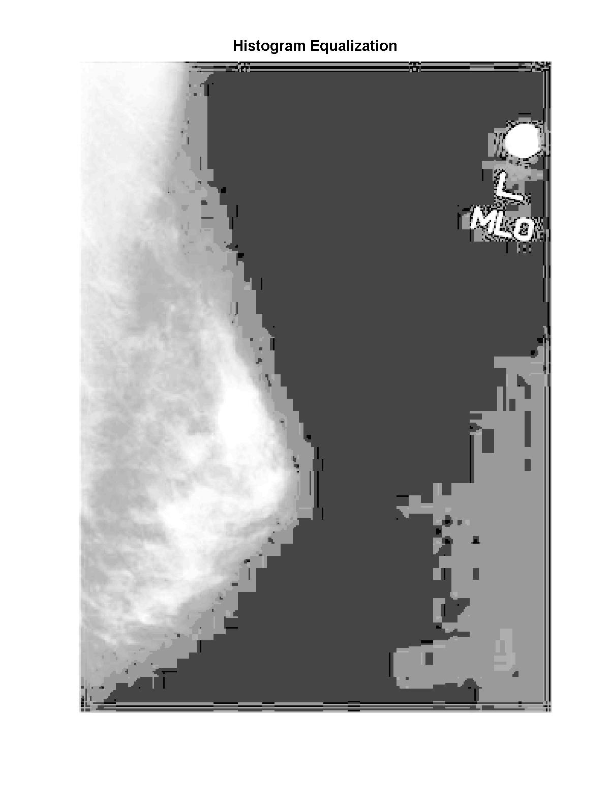
MSR compare with other techniques I

Slide 27
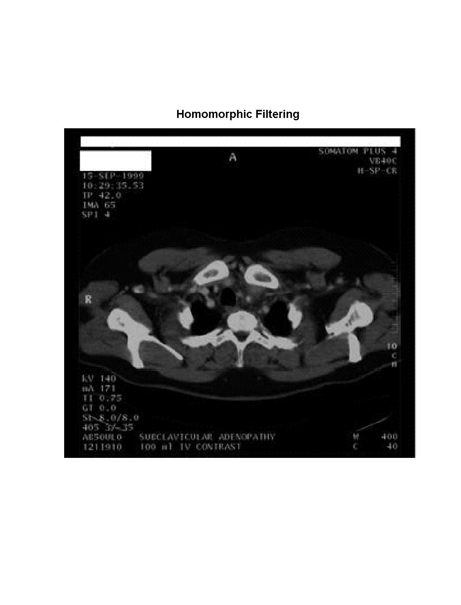
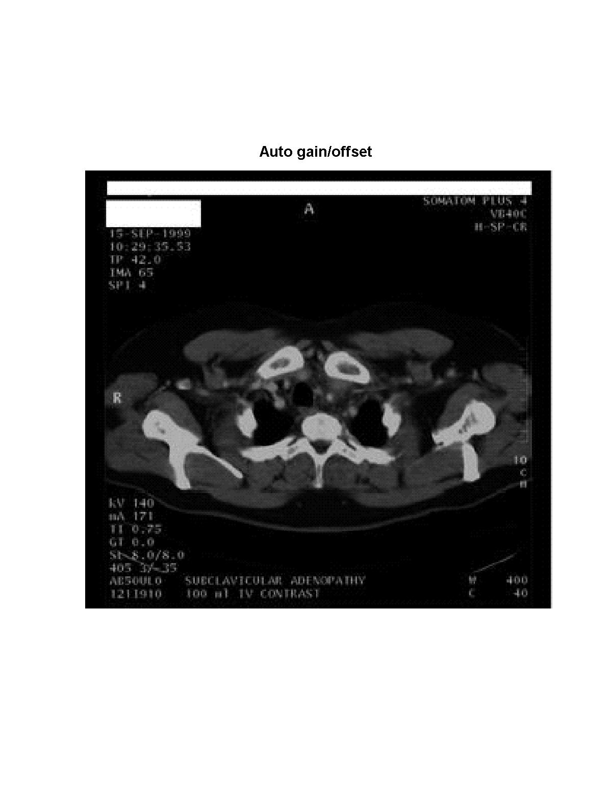


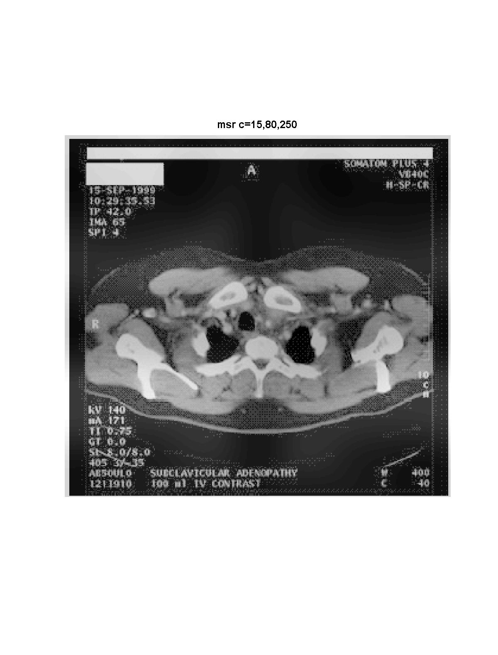
MSR compare with other techniques II

Slide 28
Summary
SSR is hard to keep balance on dynamic compression and color rendition depending on one C constant
MSR could achieve both good dynamic range compression and color rendition for gray pictures
MSRCR with canonical gain/offset shows improvements on color images
  Color restoration
  Better contrast
  However, optimized scale, gain and offset parameters should be further investigated
As compared with other techniques
  SSR and MSR are independent of inputs
    ‘Canonical’ parameters: scales, gain, offset
    SSR and MSR have much more general application and better effects for all pictures

Slide 29
Reference
E. Land, “An alternative technique for the computation of the designator in the retinex theory of color vision”, Proc. Nat. Acad, Sci., vol.83, P3078-3080, 1986
D. J. Jobson, Z. Rahman, and G. A. Woodell, ``Retinex processing for automatic image enhancement,'' Human Vision and Electronic Imaging VII, SPIE Symposium on Electronic Imaging, Porc. SPIE 4662, (2002)
Z. Rahman, G. A. Woodell, and D. J. Jobson, ``Retinex Image Enhancement: Application to Medical Images,'' presented at the NASA workshop on New Partnerships in Medical Diagnostic Imaging, Greenbelt , Maryland, July 2001
D. J. Jobson, Z. Rahman, and G. A. Woodell, "A Multi-Scale Retinex For Bridging the Gap Between Color Images and the Human Observation of Scenes," IEEE Transactions on Image Processing: Special Issue on Color Processing, July 1997
D. J. Jobson, Z. Rahman, and G. A. Woodell, "Properties and Performance of a Center/Surround Retinex," IEEE Transactions on Image Processing, March 1997
Z. Rahman, G. A. Woodell, and D. J. Jobson, "A Comparison of the Multiscale Retinex With Other Image Enhancement Techniques,'' Proceedings of the IS&T 50th Anniversary Conference, May 1997
D. J. Jobson, Z. Rahman, and G. A. Woodell, "A Multi-Scale Retinex For Bridging the Gap Between Color Images and the Human Observation of Scenes," IEEE Transactions on Image Processing: Special Issue on Color Processing, July 1997
B. Thompson, Z. Rahman, and S. Park, "A Multi-scale Retinex for Improved Performance In Multi-Spectral Image Classification," SPIE International Symposium on AeroSense, Visual Information Processing IX, April 2000.

Slide 30
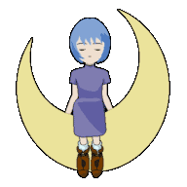
Thank you

